Slide 1
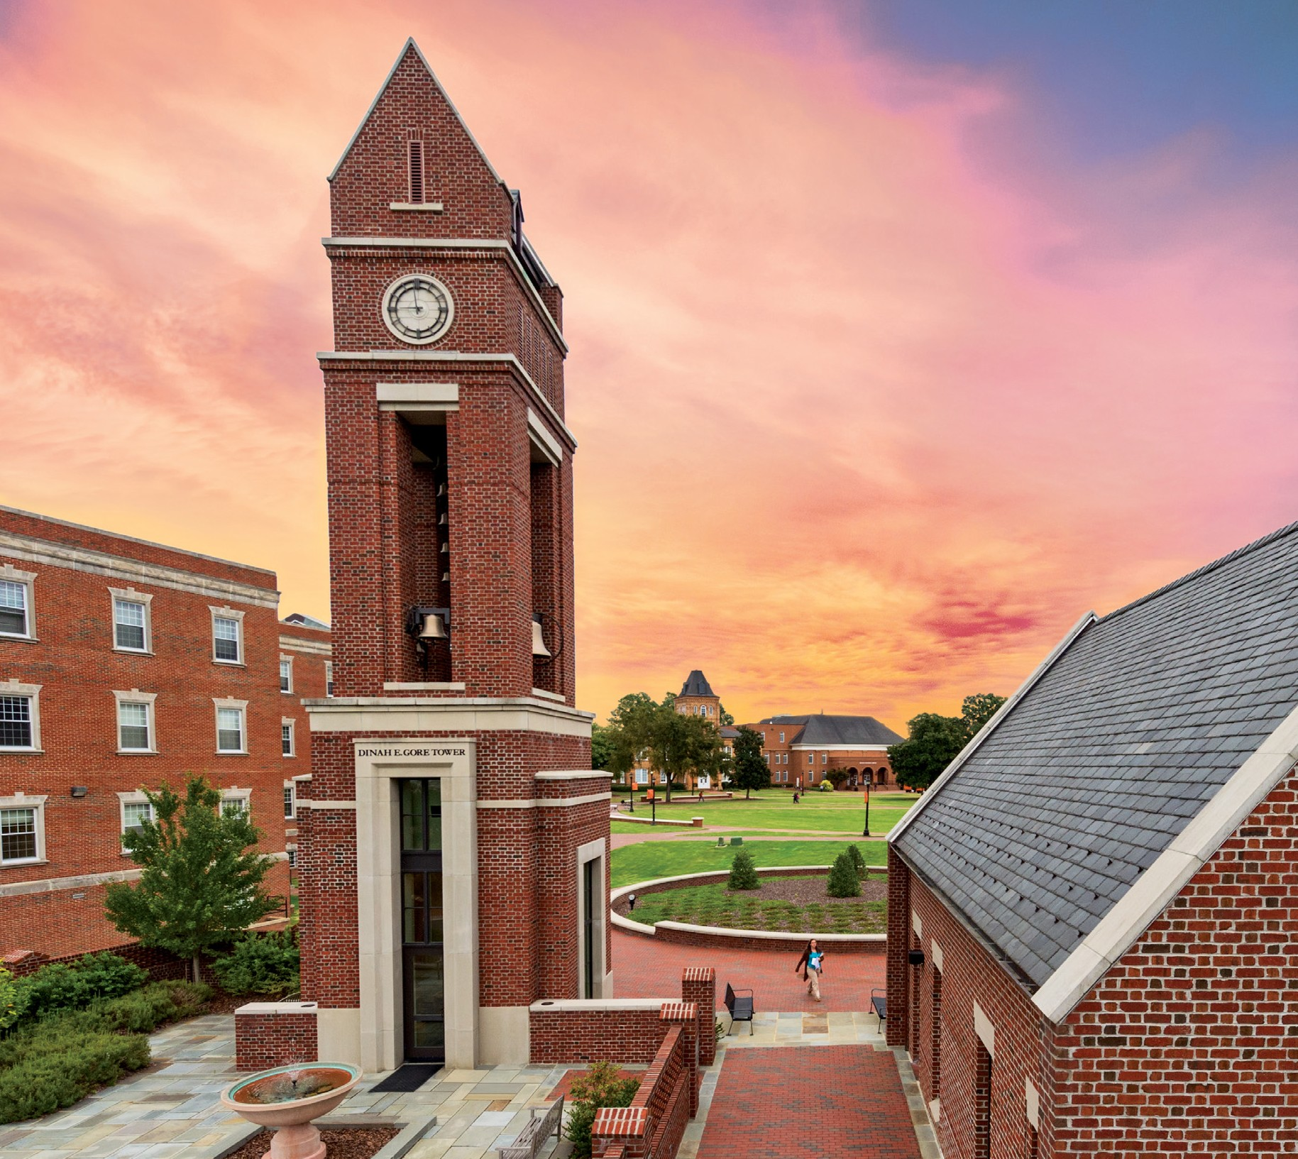

Leading with Purpose
Notes:
Campbell University is a private, co-ed university with Baptist roots that offers more than 150 majors, tracks, and concentrations. Our mission is to graduate students with exemplary academic and professional skills who are prepared for purposeful lives and meaningful service.

Slide 2
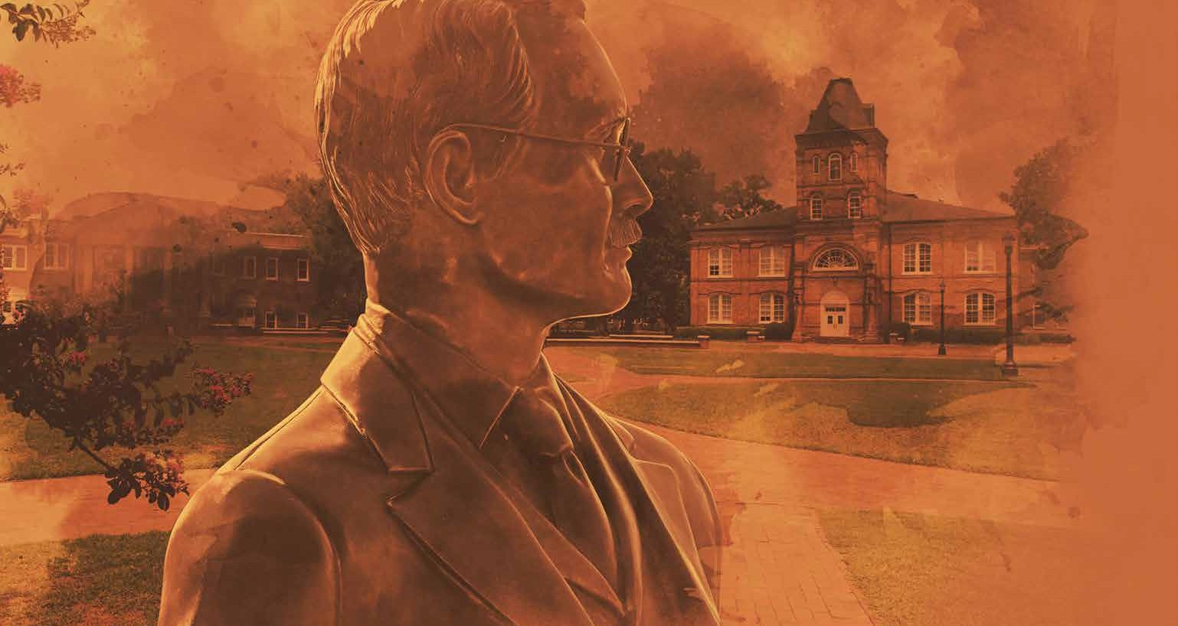

North Carolina
Greensboro
1.5 hours
Raleigh
45 minutes
Charlotte
2 hours 45 minutes
Buies Creek
Wilmington
1 hour 45 minutes

Slide 3
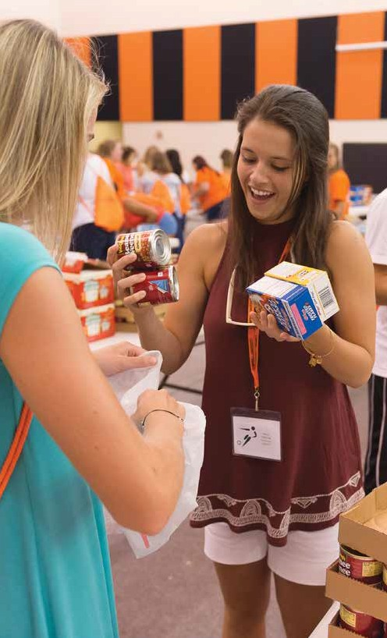



Well-Rounded,
Prepared Graduates
Service
Relevant Programs
Notes:
Continuing with the theme of service, we strive to serve those with greatest need, regardless of return. We have been forward thinking and moving, but not at the expense of our past.

Slide 4
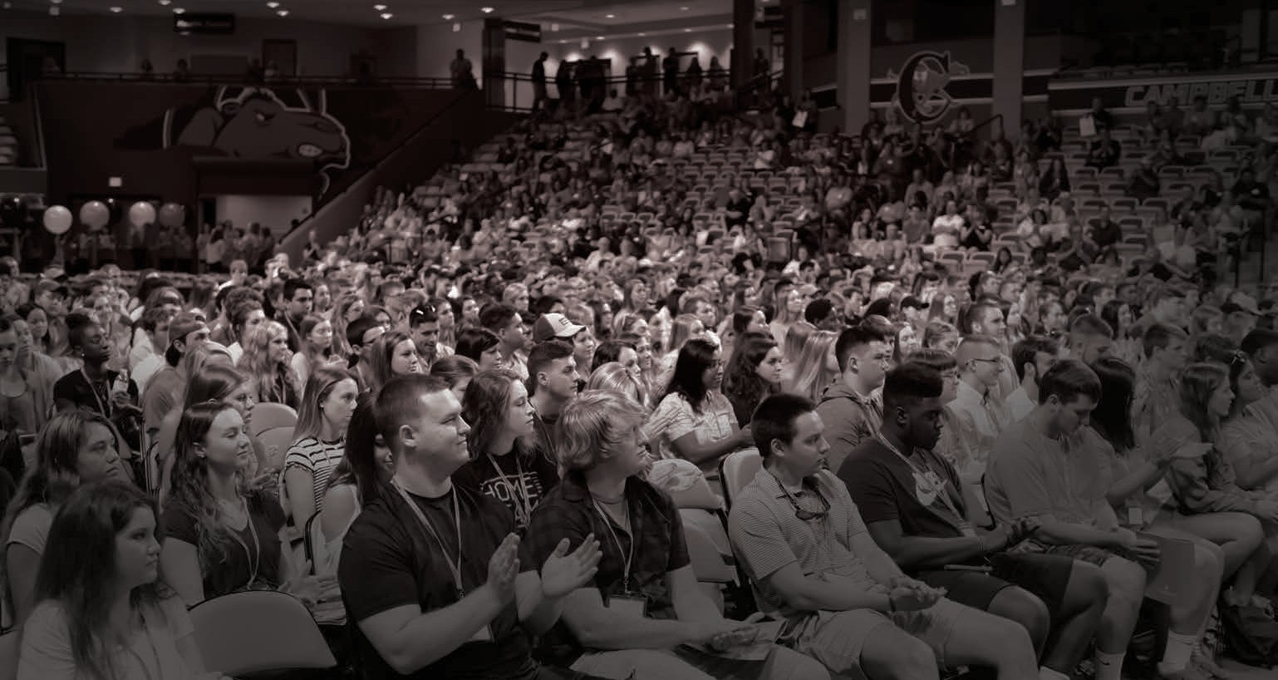
~ 3,300
52:48
2,200
Undergraduate
Students
Females to Males
Graduate
Students
Attending
Students
79% from NC, 20% Out-of-State,
1% International
46 States +
40 Countries Represented

Slide 5


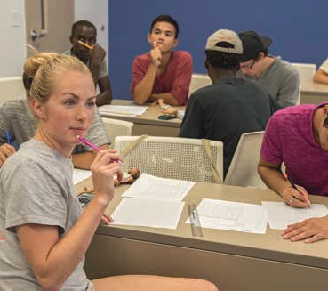
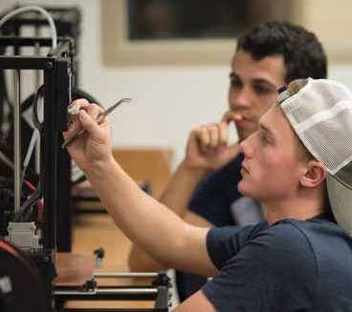

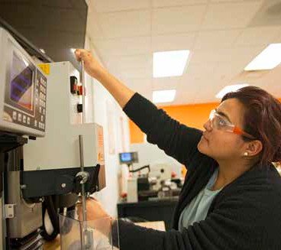
School of Engineering
Mechanical
Chemical/Pharmaceutical
Electrical
Creek Makerspace
3 Hands-On Projects Freshman Year
Notes:
hands-on, project-based freshman curriculum and a high degree of student-faculty interaction. With its location in the Research Triangle Region, students will enjoy a variety of internship and research opportunities.
*3 hands-on projects freshman year (Robot Car, Fish Tank, Design Project)
-Classes fused with labs – taught by professor, not GA or TA
-Classes capped at 24 students
-Work in teams of 3-4
*State-of-the-art facilities: Laser Cutters, Water Jet Cutter, CNC Mill and Lathe **EVERY STUDENT IS REQUIRED TO USE EQUIPMENT. **
-Internships: Daniel in Africa, etc.- worked on elephant deterrent for villages with Army Research Labs, CAT, Pzifer, Novo Nordisk, 3M, and Boom Edam.

Slide 6
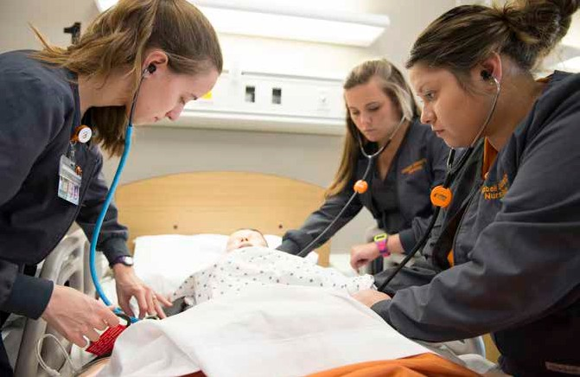






Catherine W. Wood School of Nursing
Bachelor of Science in Nursing (BSN)
Clinical rotations starting in the first semester
First-year students are classified as Pre-Nursing
Apply to nursing school during
the sophomore year
92.68% NCLEX Passage Rate
100% of job-seeking grads employed
Strong relationships with providers including:
Notes:
50 seats available
Sim labs, manicans
ER set up/triage - Drs Office setup

Slide 7
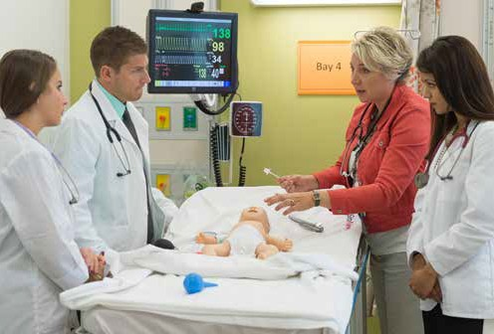

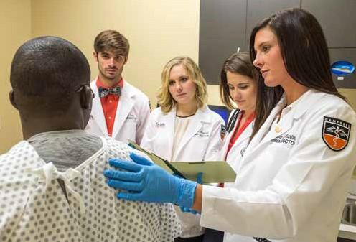

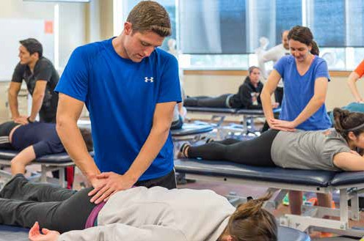
Jerry M. Wallace School of Osteopathic Medicine
BODY
MIND
SPIRIT
Notes:
The concept of osteopathic medicine is that they treat the entire patient rather than just the symptoms.
Treat patient as integrated whole: mind, body, and spirit.

Slide 8


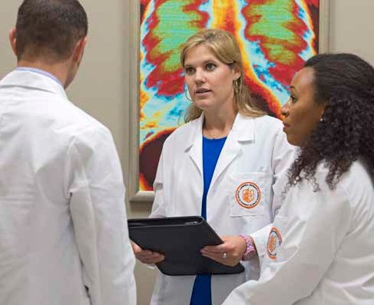
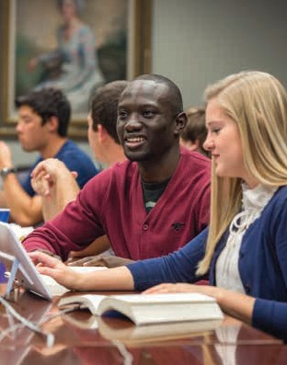
Lundy-Fetterman School of Business
Accounting
Business Administration
Economics
Finance
Healthcare Management
International Business
Marketing
PGA Golf Management
Trust & Wealth Management
MBA (4+1)
MTWM
MAcc
AA offered in General Business
Notes:
The First Citizen’s Wealth Management Center provides a cutting edge classroom, specialized training, real world experience, and software knowledge.

Slide 9
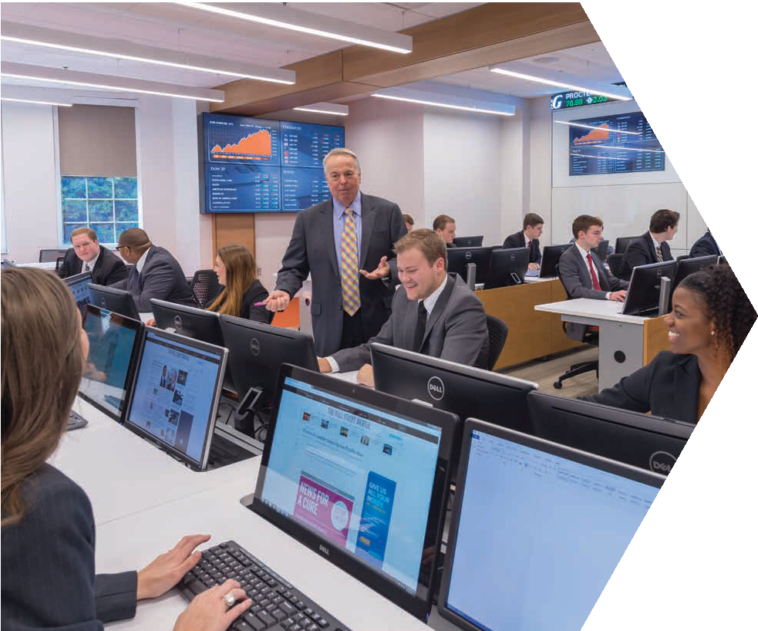





4+1 MBA Program
Lundy-Fetterman
School of Business
Career Services
Peer Mentors
Entrepreneurship
Paid Internships
Notes:
Undergraduate business students can earn a Bachelor of Business Administration degree and a MBA degree in 5 years through the 4+1 option.

Slide 10







Lundy-Fetterman
School of Business
95%
Job placement
CFP & CTFA
Eligible upon graduation
ONLY
Undergraduate
Trust & Wealth Management program in the country
Internships include:
Notes:
Eligible to sit for the Certified Financial Planner and Certified Trust and Financial Advisor certification examinations immediately upon graduation.
Internships with various companies including Wells Fargo, Bank of America, JP Morgan, First Citizens, BB&T, and Regions Bank.
9 Different Majors
In- House Career Services and Student Success
4+1 MBA Option
Entrepreneurship Opportunities/ entrepreneur portfolio
Real Projects and Collaborations
Paid Internships
Trust and Wealth Management program- Only one in the nation
PGA Golf Management Program- 1 in 18 in the nation
“Committed to growing students personally and professionally”
Six Sigma Leadership Certificate training
Only undergraduate Trust & Wealth Management program in the country
Students earn jobs as trust officers, financial planners, investment managers, estate planners, corporate attorneys, etc.
Eligible to sit for CFP & CTFA exams upon graduation
Paid internships across the country
Over 95% of graduates placed in jobs within one month

Slide 11



School of Education
Programs
Birth-Secondary Education
Curriculum Materials/Media Center
Psychology
Social Work
Special Education
Master of School Administration
M.A. in Mental Health Counseling
M.Ed. (Elementary, Middle Grades, Secondary Education, Physical Education, and School Counseling)

Slide 12


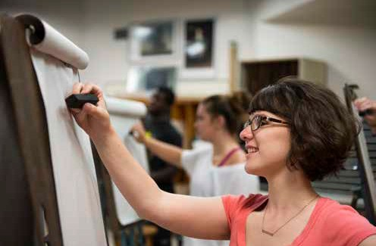

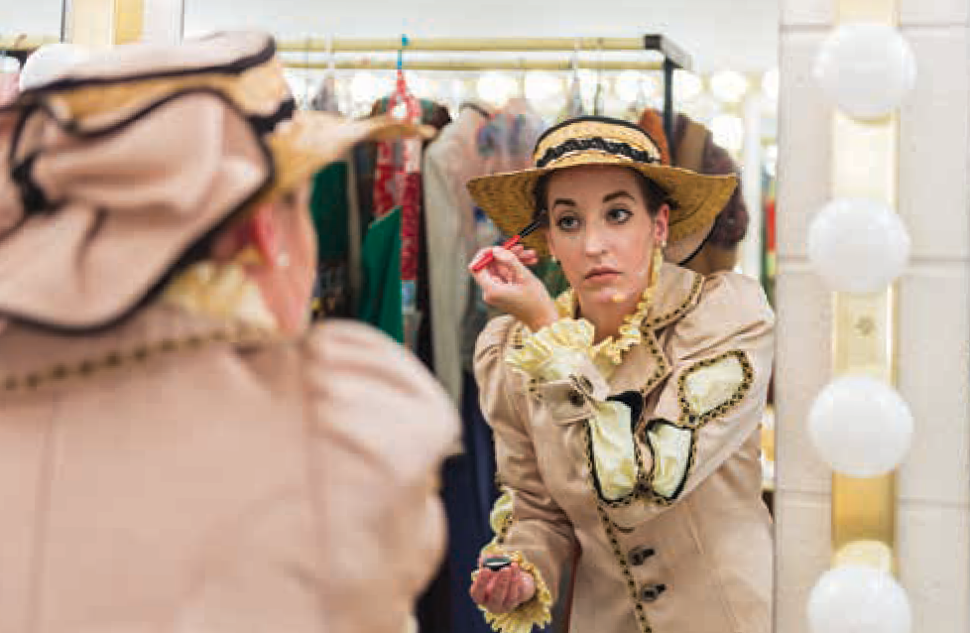

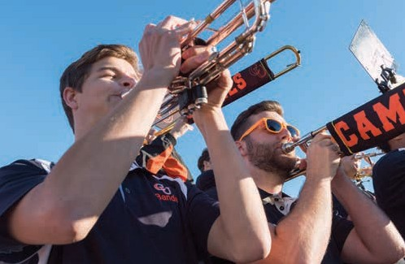
College of Arts & Sciences
THEATRE
MUSIC
ART

Slide 13



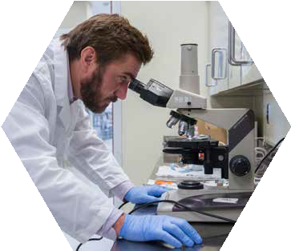


Biology & Chemistry/Physics
Campbell graduates have earned advanced degrees including: DDS, DO, DPT, MD, PA, PharmD, and PhD
40–50
students participate in undergraduate research each year
Internship opportunities vary from Walt Disney World’s Animal Kingdom to GlaxoSmithKline
Graduates have attended: Campbell, Duke, ECU,
Johns Hopkins, UNC, Vanderbilt, Wake Forest, and Yale

Slide 14



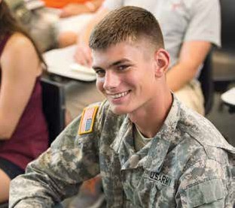
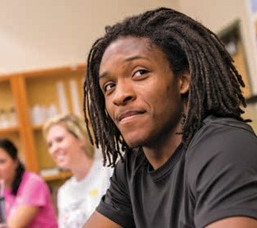
College of Arts & Sciences
Departments
Christian Studies and Humanities
Communication Studies
English
Exercise Science
Foreign Language
History, Criminal Justice, & Political Science
Mathematics
Security & Computing
ROTC – Air Force and Army
Notes:
English, Communication Studies, Foreign Language
• “Premier pre professional degree”
• English Pre-Med
Communication
• Four Majors B.A. Comm., Studies, B.S. in Health Comm., B.S. Training and Development.
• 4+1 Master of science in public Health
• 3+3 pre-law/Juris Doctorate (one less year of School)
• Campbell times, Pine Burr, Campbell Now are all production opportunities on campus
• Professional standard TV production studio.
Mathematics/Information, Christian Studies
Christian Studies concentrations: Ministry, Youth Ministry, Pre-Law
3+3 programs with divinity school
Exercise Science:
4+1 Sports Management BS/MBA Dual Degree Program
• Computer Laboratory furnished with metabolic analyzer, fitness testing treadmill, bicycle ergometers and other fitness assessments systems suitable to conduct student research at high level.
ROTC
• Leadership program not major
• 74-100 students
• Participate for two years with no commitment to the army
• 4 full tuition scholarships as freshmen, 6 students get 3 years of full tuition
• Roughly 50 juniors/ seniors receive scholarship.

Slide 15


Criminal Justice, History, & Political Science
Programs
Criminal Justice
History
  International Studies
  Teacher Licensure
Political Science
  International Studies
  Public Administration
Notes:
Criminal Justice, political science
-Class Size 10-12
-Internships with local professionals and agencies
-undergraduate research
Student quote: “I have come to realize how rare my experience at Campbell was. I had professors that I went to daily for everything whether it was academic or personally…”
-FBI academy training

Slide 16
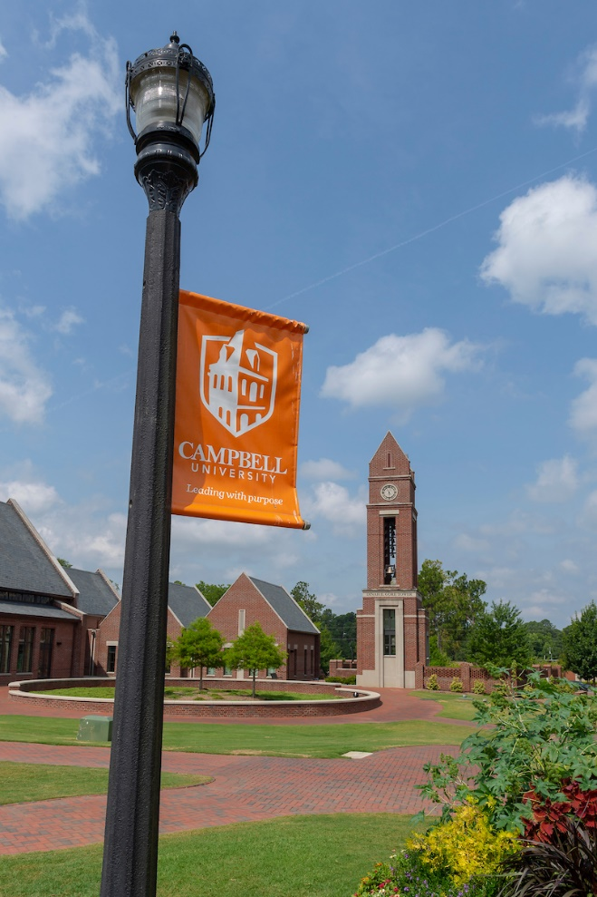
Security & Computing
Programs
Cybersecurity
Homeland Security
Information Technology & Security
  Information Security
  IT Management
AA Degrees offered in
  Information Security
  Information Technology Management

Slide 17

Norman Adrian Wiggins School of Law
3 + 3 Accelerated Dual Degree Program
Based in downtown Raleigh
Top bar passage rate of all NC law schools
$10,000/year scholarship
Nationally recognized Mock Trial team
Extensive
alumni network
Notes:
Top bar passage rate of all NC law schools, and ranked #2 law school for bar passage rate in the country.
Extensive alumni network, including 15 district attorneys, two NC Court of Appeals judges, and the NC Secretary of State.
3 + 3 Accelerated Dual Degree Program through undergraduate BA in Liberal Arts.
Presents the practice of law as a way to make a difference by serving others.

Slide 18




Student Success
First-Year Experience
Career Development and Career Fairs
Counseling Center
and Self-Help Resources
Tutoring and Writing Center
Academic Advising Center
Notes:
The Student Success Office at Campbell offers many different things to help students be successful! Campbell University Freshmen Seminar is a class that helps students adjust to life at college. The focus of CUFS is student success and highlights skills such as developing study habits and time management. Free tutoring and a writing center are available for students in the library. A counseling center and other resources are also available. Career Development help and an annual Career Fair are offered.
First-Year Experience (CUFS 100, BADM 100, NURS 100, PHARM 100, ENGR 100): This class allows students to have guidance in adjusting to college life. It centers around ensuring the success of a new student by focusing on important skills like good study habits or the ability to effectively manage their time. The classes encourage freshmen to be open and honest about their perceived challenges.
Tutoring and Writing Center
Counseling Center and Self Help Resources

Slide 19
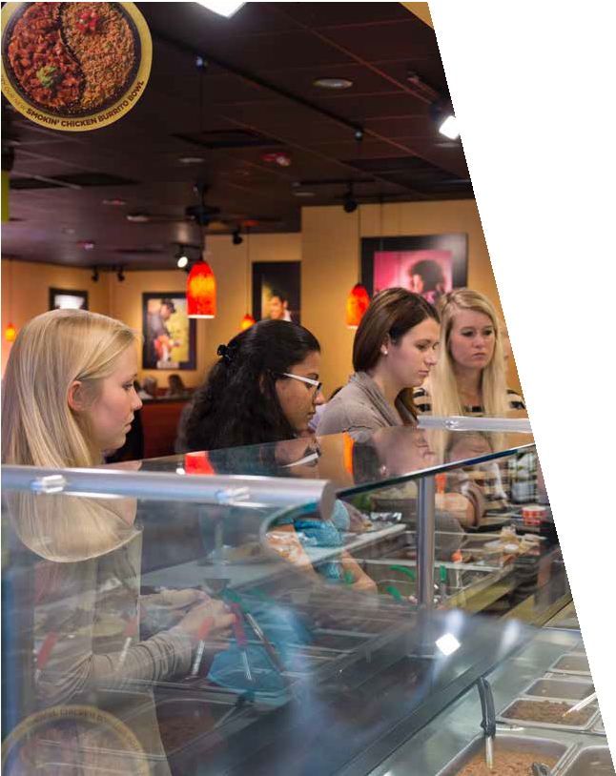








On-Campus Dining
Notes:
There are many campus dining options including Chick fil a, Moe’s, and Starbucks. Feel free to talk about meal plan options, Gaylord’s Kitchen, swipes at sporting event concessions, local places to eat, etc. here.

Slide 20


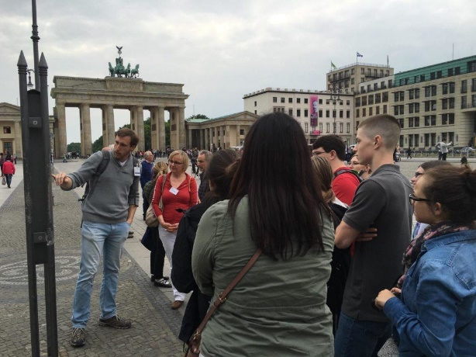
Global Engagement
Crime & the Cold War in Eastern Europe
Ecology and Culture in Hawaii
Education & Social Work in Costa Rica
Homeland Security in London & Paris
Psychology in Europe
Instagram: @CampbellAbroad
Notes:
We offer Global Engagement opportunities within the United States and in over 50 countries! Trips take place during Fall break, Spring break, summer break, and winter break, or students can opt for semester-long and year-long programs. The Office of Global Engagement has an event at the beginning of each semester that showcases opportunities for upcoming trips! Some trips are within a specific major, but students do not have to be studying that topic in order to go on the trip! Trips include both tourist-y features as well as educational information. Trips can be professor-led or partnerships with other organizations/universities.

Slide 21
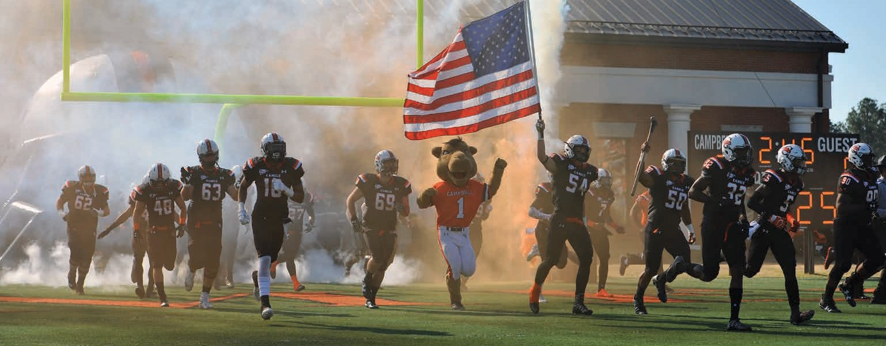


Student Activities
100+
Student Clubs & Organizations
9
4
50+
21
Fraternity
& Sorority Options
Club &
Intramural Sports Available
Fighting
Camels Athletic Teams
Student Media Outlets
Notes:
With over 90 clubs and honor societies, you’ll always be busy!
CAB (Campus Activities Board):
Mud Volleyball, Beach and Mountain Trips, Spring Break Cruise, Friday Night Movie Night, and more!

Slide 22

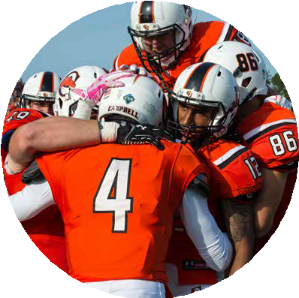
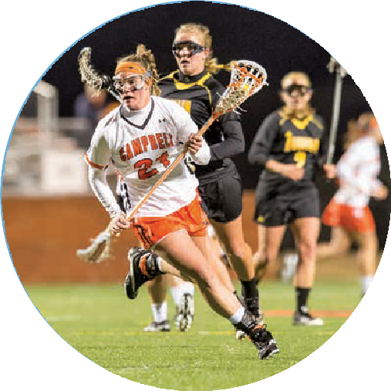





Athletics
NCAA Division I Sports
Men:
Women:
Baseball Basketball Cheerleading Cross-Country Football
Golf Soccer Tennis
Track and Field Wrestling
Basketball Cheerleading Cross-Country Golf
Lacrosse Soccer Softball Swimming Tennis
Track and Field Volleyball
Notes:
Athletics at Campbell is a big part of the college experience. We have Division 1 sports and are in the Big South Conference except for swimming and wrestling. We are part of the Southern Conference for wrestling and the Coastal Collegiate Swimming Association.

Slide 23
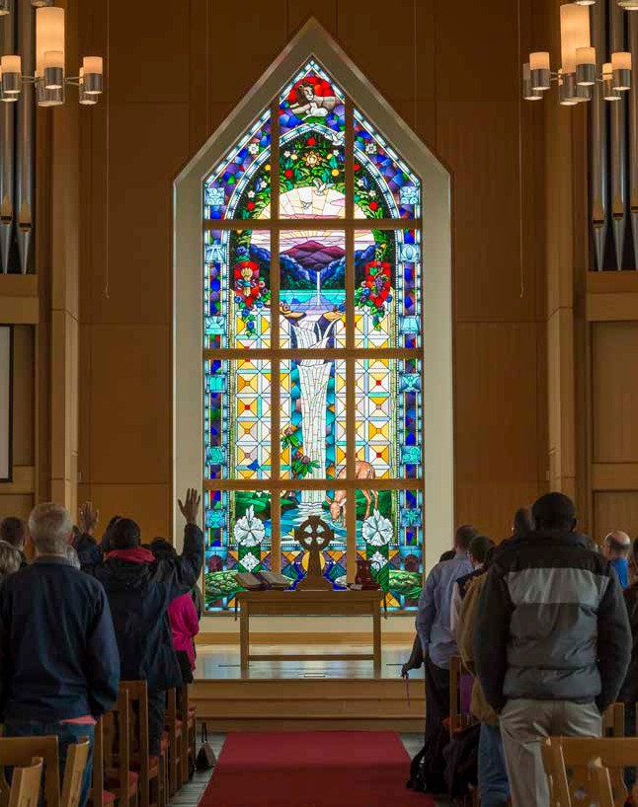

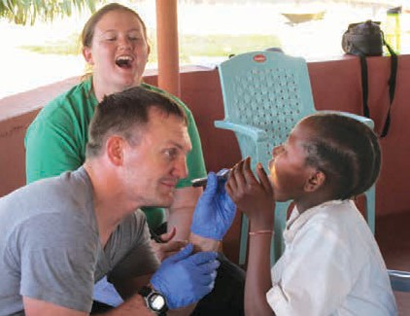

Faith. Learning. Service.
Campus-Wide Operation Inasmuch
MLK Day of Service
Resident Chaplains
Mission Trips
Connections
Service Learning
Sunday Night Campus Worship
Notes:
Three very important aspects of life at Campbell include Faith, Learning, and Service. Mission trip opportunities in the past have included East St. Louis, Georgia, Honduras, Ukraine, Italy, India, South Africa, Hungary, and Nashville. Campus-wide Operation Inasmuch is an annual event that takes place across Harnett County. Martin Luther King Day of Service also takes place annually. Each Sunday night, a student-led campus worship takes place in Butler Chapel. Resident Chaplains are graduate students that live in each dorm and plans bible studies for students. They are also available when students need to just talk. Connections takes place each week for Freshmen and Sophomores. It is a time to come together as a class and hear from a guest speaker or a ministry group. Connections merges the university’s hallmarks of faith, learning, and service together to educate, challenge, and prepare students to live and act responsibly in this world.

Slide 24

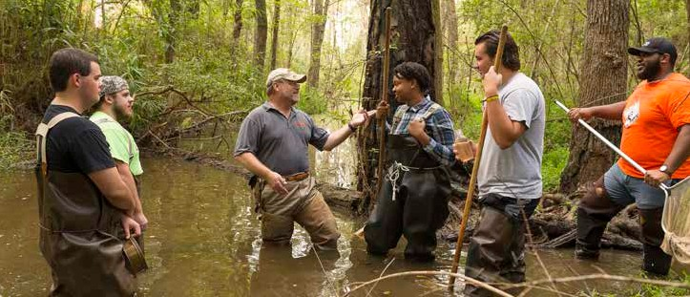
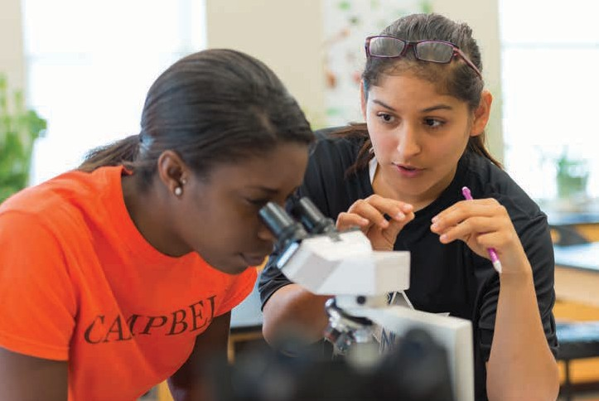
[
{
3.5
[
14:1
{
Average GPA
unweighted
Student to Faculty
{
}
[
15-20
Average Class Size
86%
[
Faculty with Highest Degrees

Slide 25





Requirements for Admission:
Free
Application
Official
Transcript
*Official Test Scores (SAT and/or ACT)
*Test Optional for course placement only
AP Score Reports | Community College Credits
Notes:
Our Admissions Department offers rolling admissions-meaning that there are no hard deadlines. You can apply as early as the completion of your junior year. The application is free through our website. We will need your completed application, official high school transcript, and official SAT and/or ACT scores before we can fully accept you. We super-score the SAT and ACT, meaning that we use the highest sections from each attempt when reviewing the scores. Residual ACT option.

Slide 26


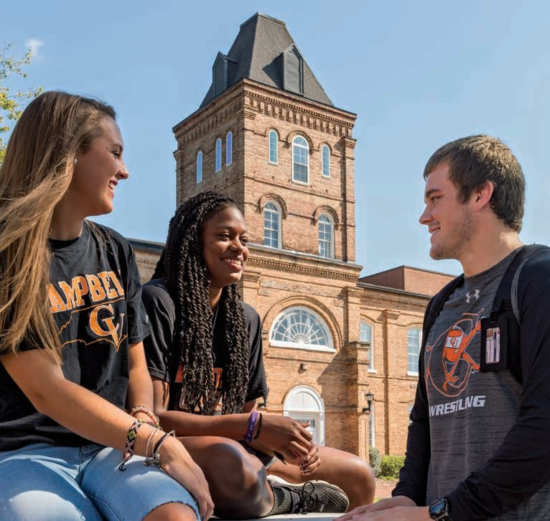

Scholarships
Merit-Based Scholarships
Need-Based Scholarships
Outside Scholarships Accepted
Endowed Scholarships Available

Slide 27

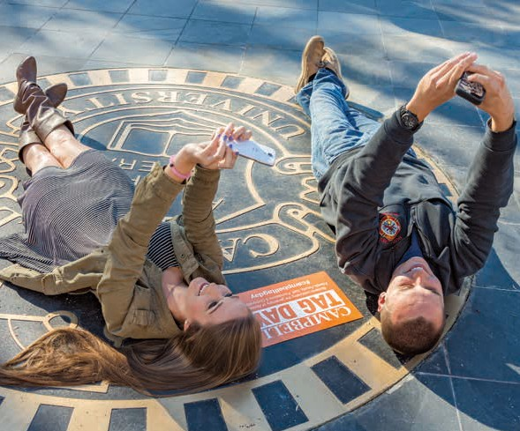
Questions?
910-814-5783
cdstafford@campbell.edu
admissions@campbell.edu
Facebook: Campbell University Admissions
Instagram: CampbellAdmissions

